Slide 1


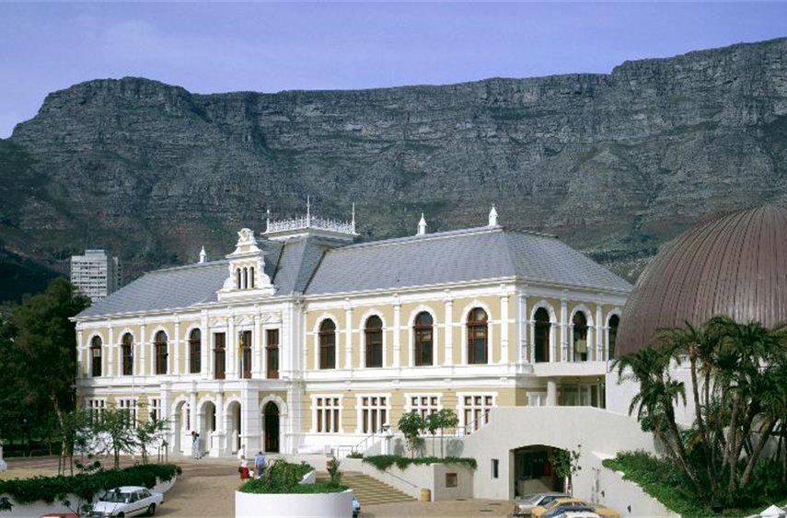




Travel Information
SPNHC (AFRICA) 2026 41st Annual Meeting
Cape Town, South Africa
Second Week of September 2026
Iziko South African Museum
Bridging Hemispheres:
Collaborating for a Unified Natural Heritage

Slide 2
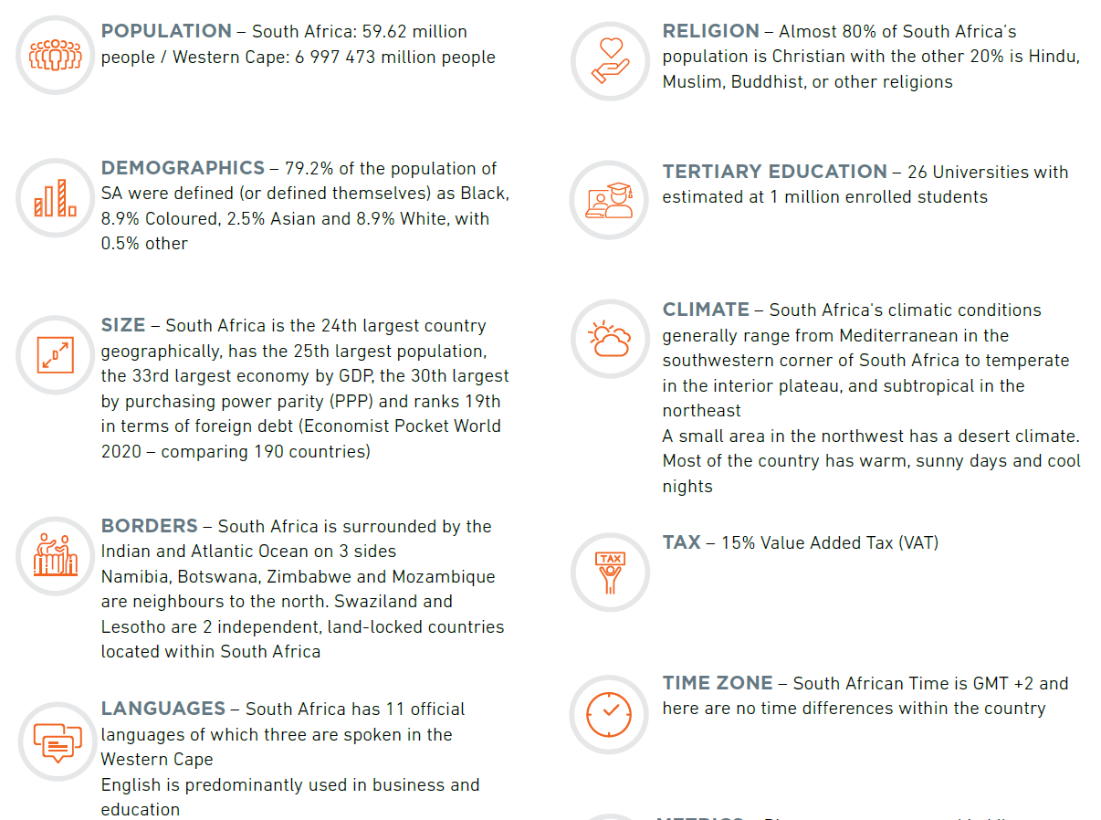

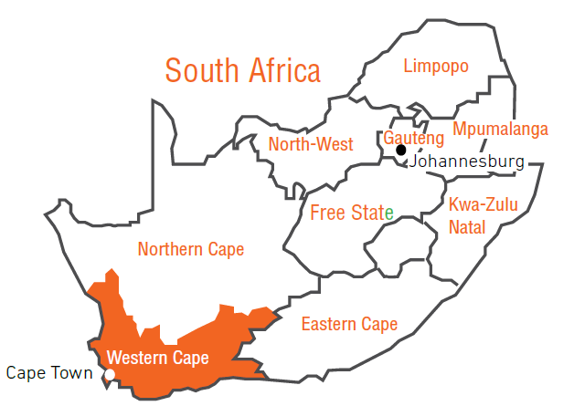


Slide 3
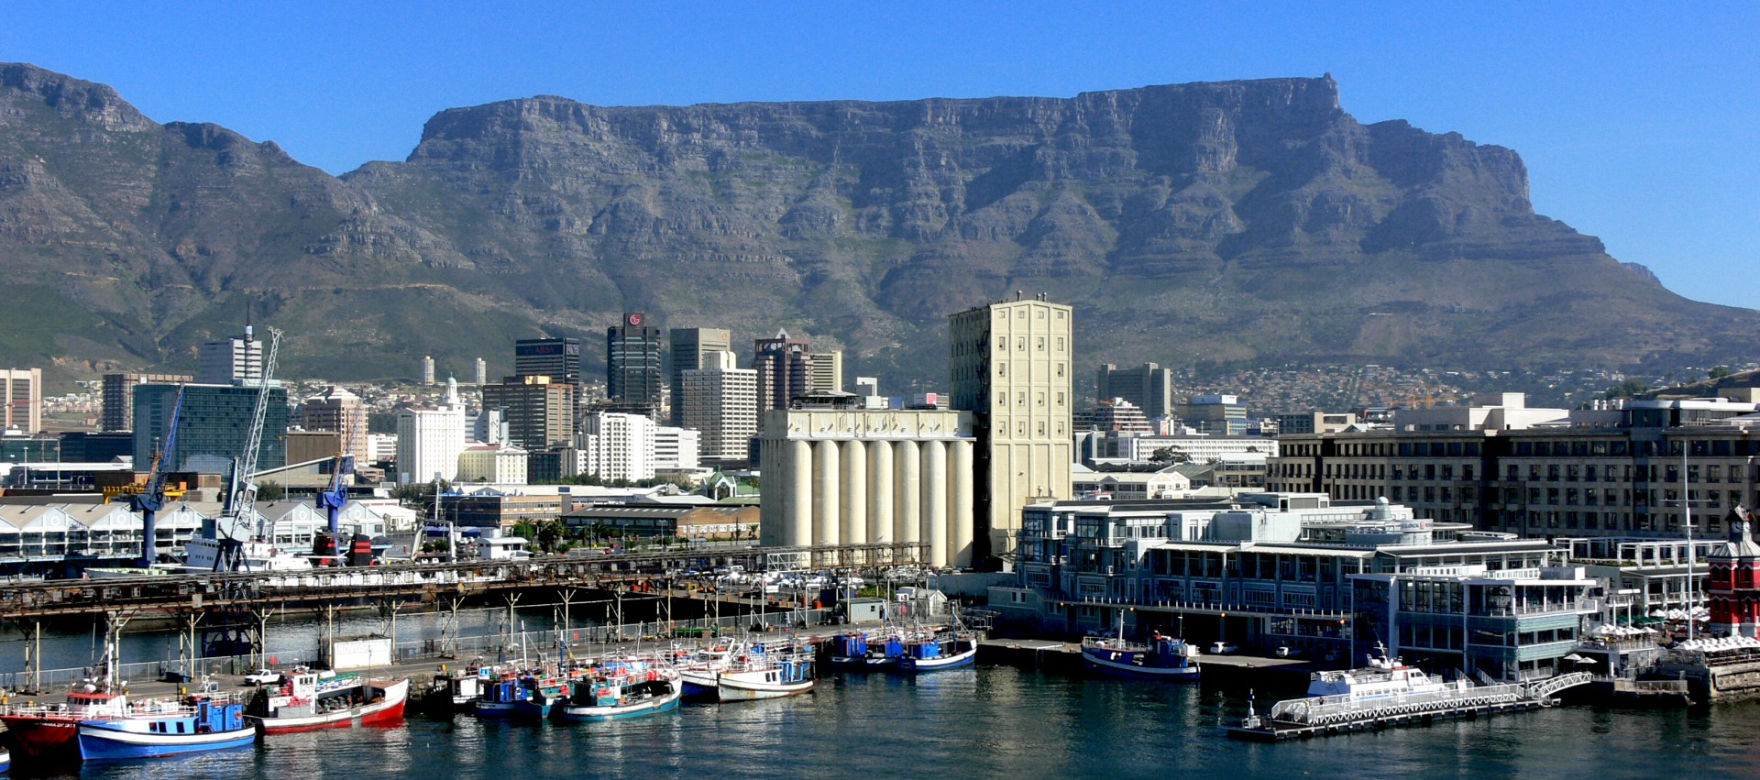





Slide 4

Cape Town Weather in September
Spring begins in the Southern Hemisphere
Temperatures: 11°C (52°F) to 20°C (68°F)
Mix of crisp, clear days and occasional rain
Wildflowers bloom along the West Coast
A refreshing transition into summer

Slide 5
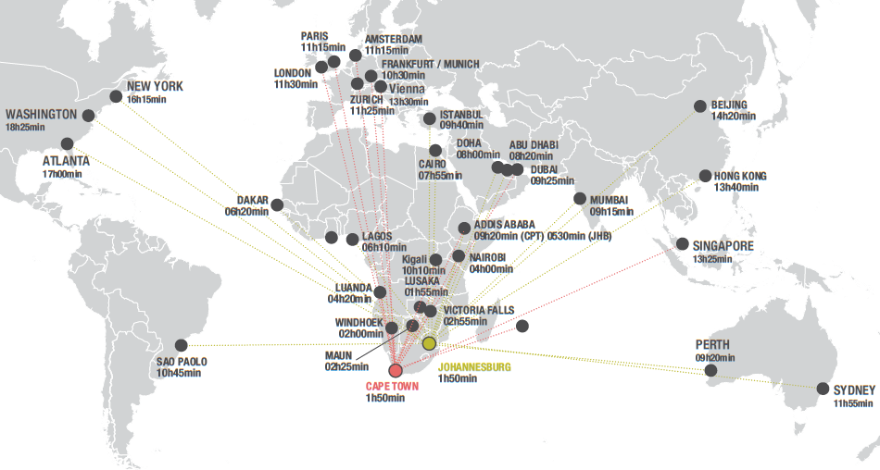

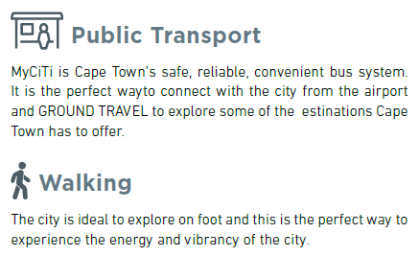
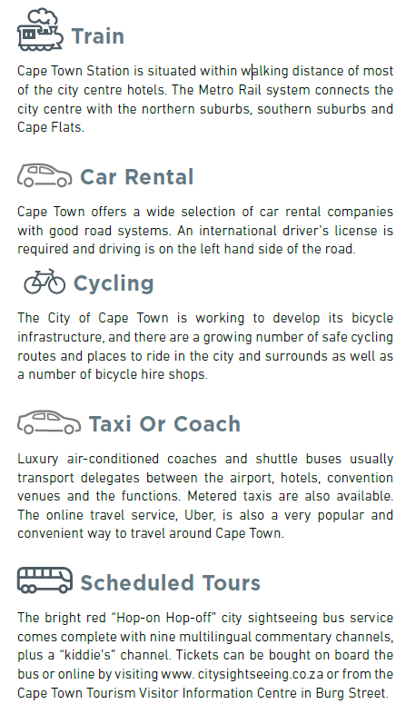

Slide 6
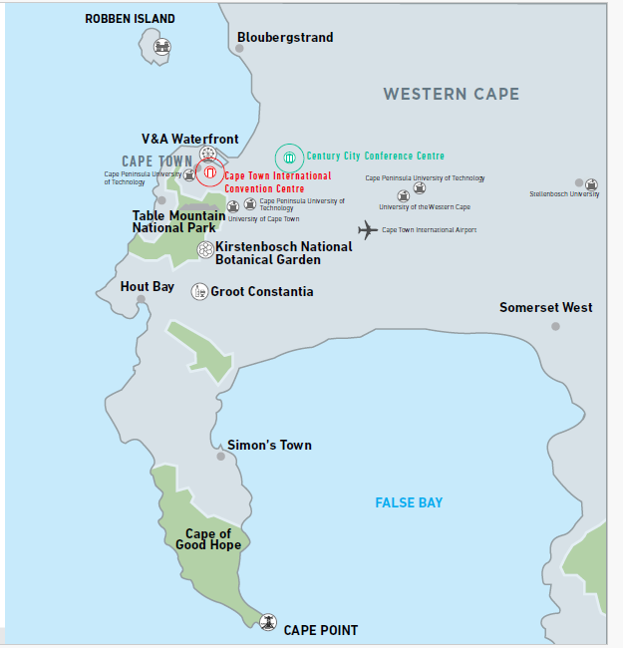
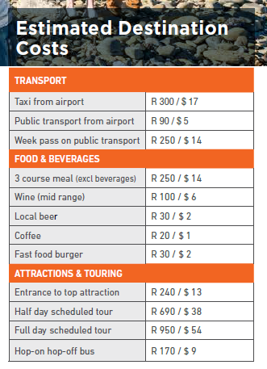


Iziko South African Museum

Slide 7
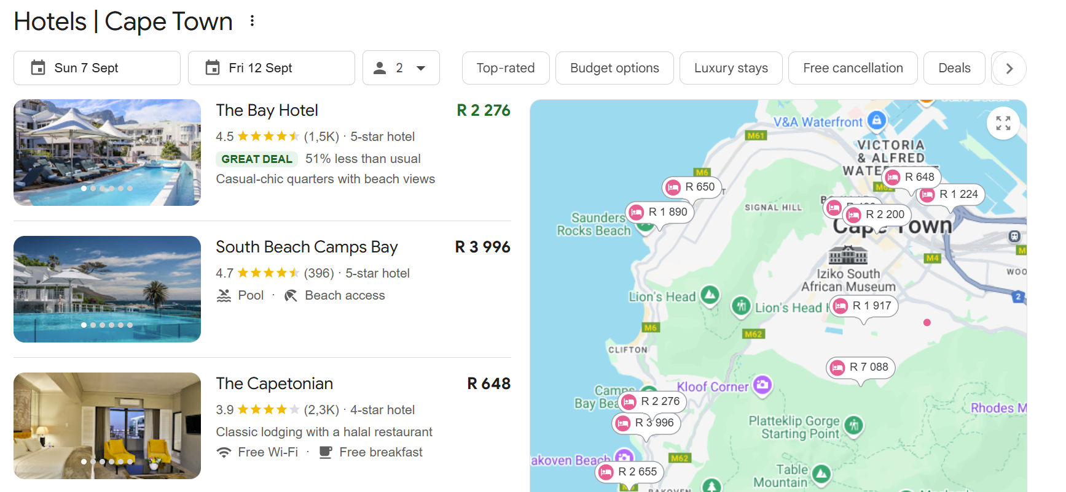
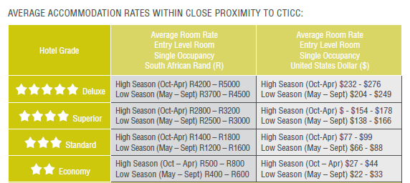
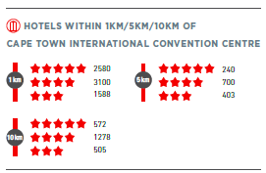

Slide 8
